Slide 1
HABITAT FOR HUMANITY TINY HOME AFFORDABLE HOUSING SITE DESIGN IN FLAGSTAFF, ARIZONA
CENE 486 CAPSTONE PRESENTATION
APRIL 26th, 2019
ANNA KURN
MICHAEL BULRISS
DAVID BORJA
ABDULRAHIM ABDULLAH

Slide 2
PROJECT UNDERSTANDING
Purpose
Development of 50 Tiny Homes to provide affordable housing solutions for teachers in Flagstaff
Preliminary site design with grading and drainage, roads and gutters, utility layout, and preliminary cost estimate
Client: Dr. Steve Mead
Joint Venture with Habitat for Humanity and Flagstaff Unified School District
Technical Advisor: Stephen Irwin
Shepard-Wesnitzer Inc.

Slide 3

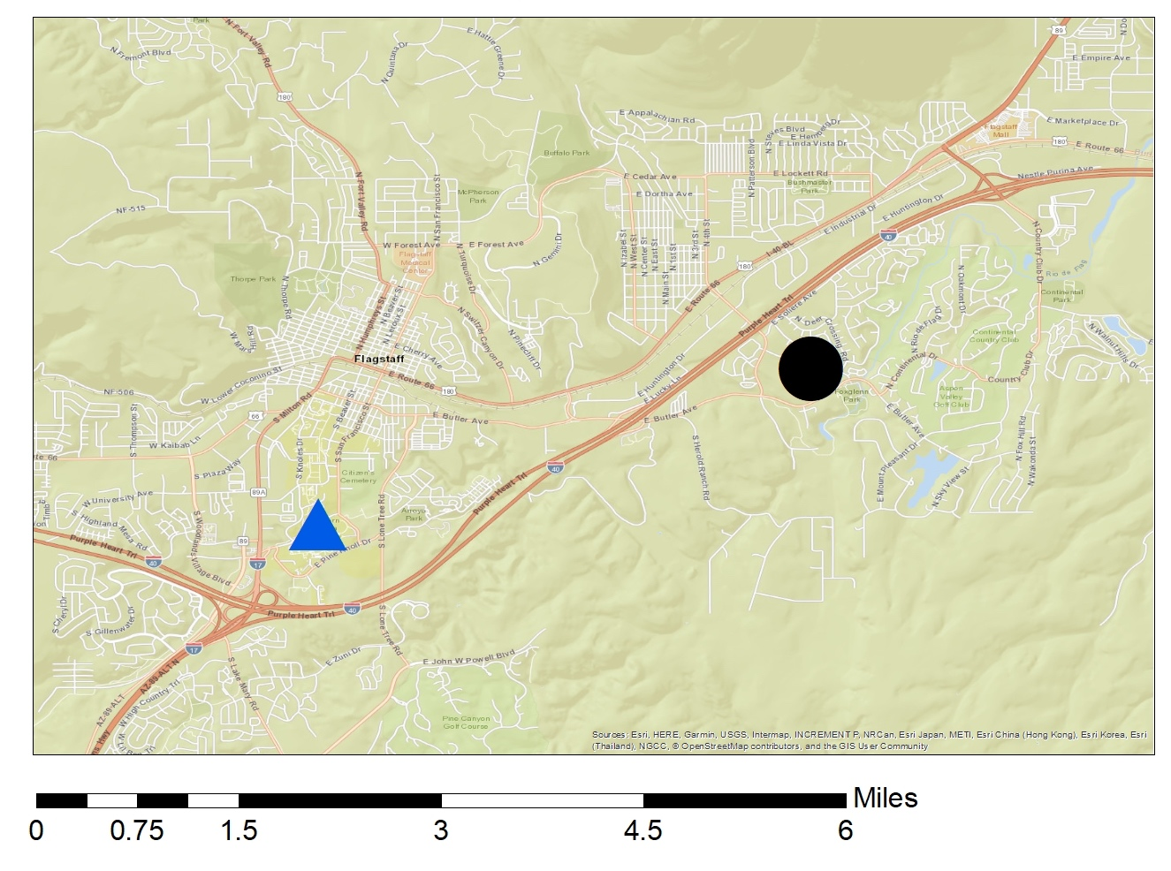
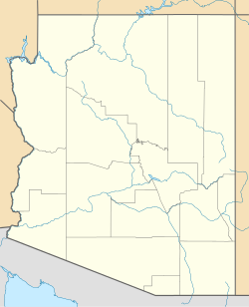
LOCATION
NAU Campus
Project Location
Flagstaff, Arizona
I-40
Figure 1: Project Location for Habitat for Humanity Affordable Housing development in Flagstaff, Arizona. [1]

Slide 4
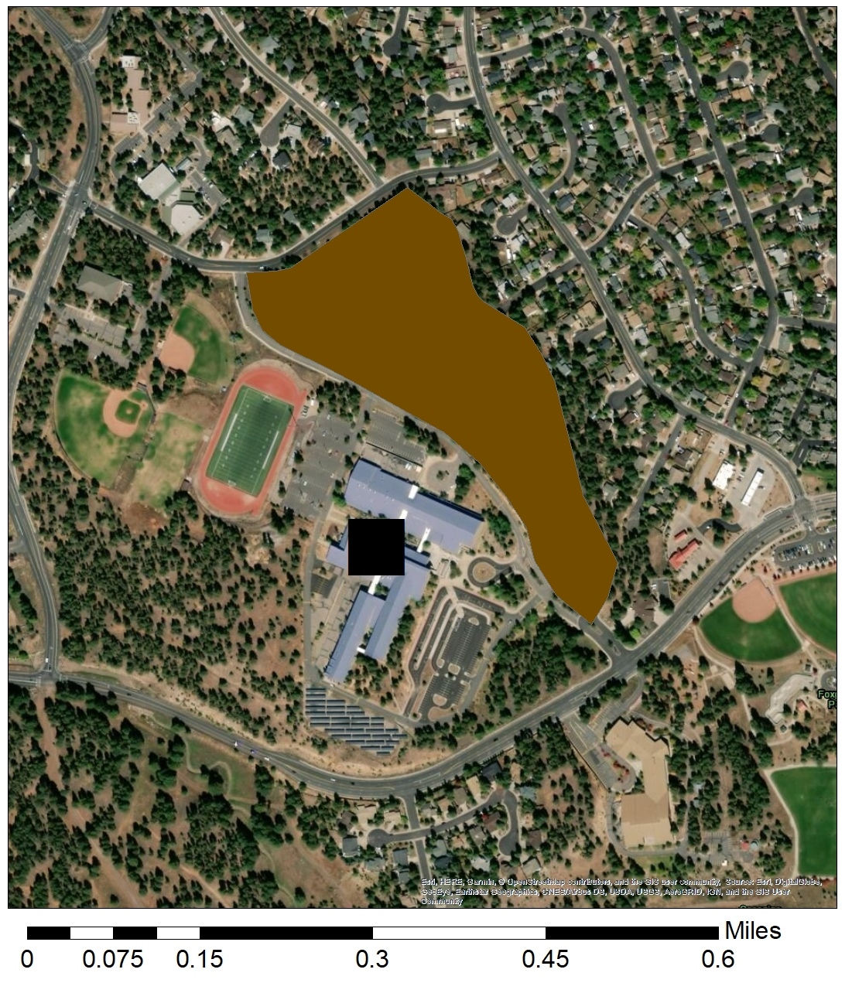

LOCATION
NAU Campus
Project Location
Sinagua Middle School
East Butler Avenue
Flagstaff, Arizona
Figure 2: Project Location for Habitat for Humanity Affordable Housing development in Flagstaff, Arizona. [1]

Slide 5
PROJECT SCOPE
Preliminary Site Visit and Assessment
Road, Curb, and Gutter Design
Grading and Drainage Design
Utility Layout and Coordination
Conceptual Plan Set
Preliminary Cost Estimate for Development

Slide 6
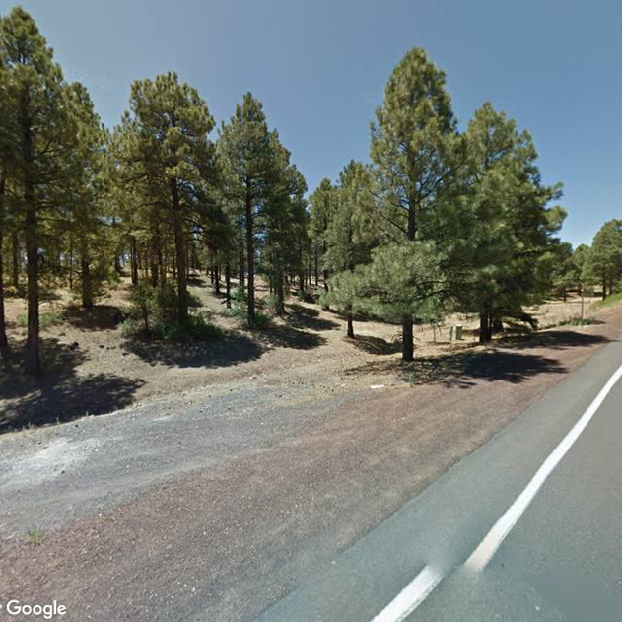
PROJECT LIMITATIONS
Challenges:
Site Topography
Communal Parking Lot / ADA Compliance
Exclusions:
Survey and Tree Survey
Geotechnical Analysis
Traffic Impact Analysis
Structural Engineering/Retaining wall designs
Figure 3: Photo of Project Site Location from Sparrow Ave. [1]

Slide 7
PROJECT IMPACTS
Environmental Impacts
Loss of Trees
Large amounts of earthwork
Transportation of Import and Export materials
Economic Impacts
Provides Affordable housing for teachers
Grants likely needed to subsidize proposed development
Social Impacts
New development in a neighborhood
Children play in the area
Retention of teachers in the Flagstaff Community

Slide 8
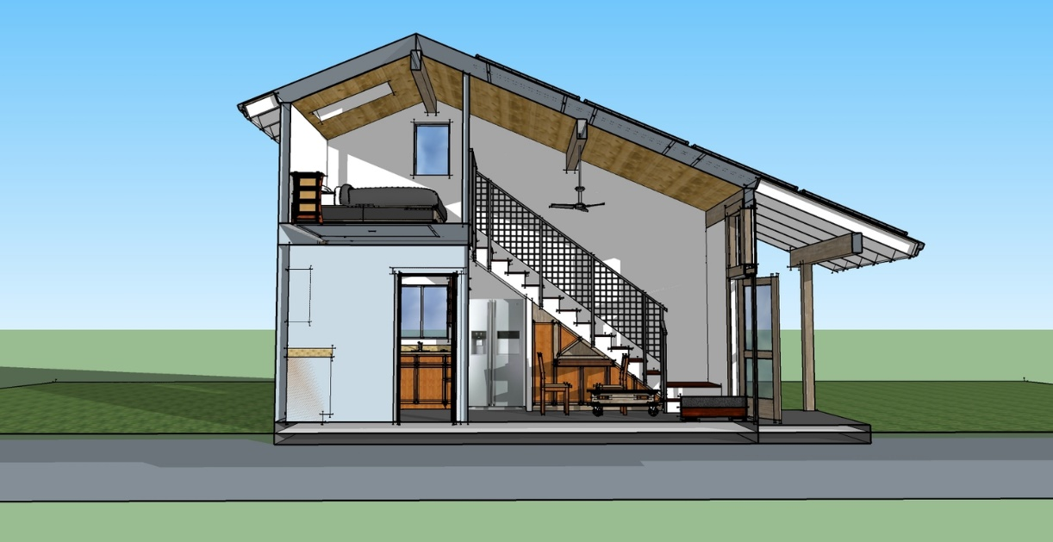
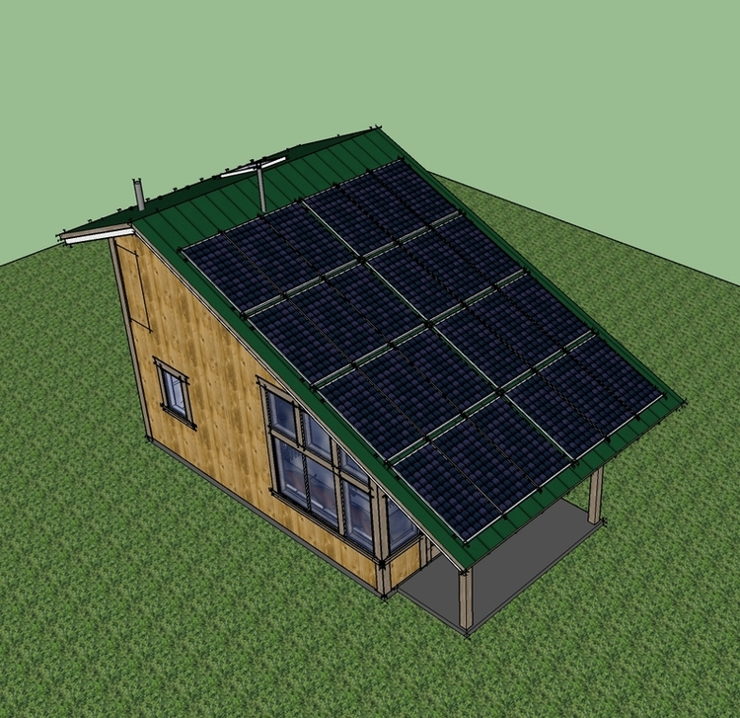
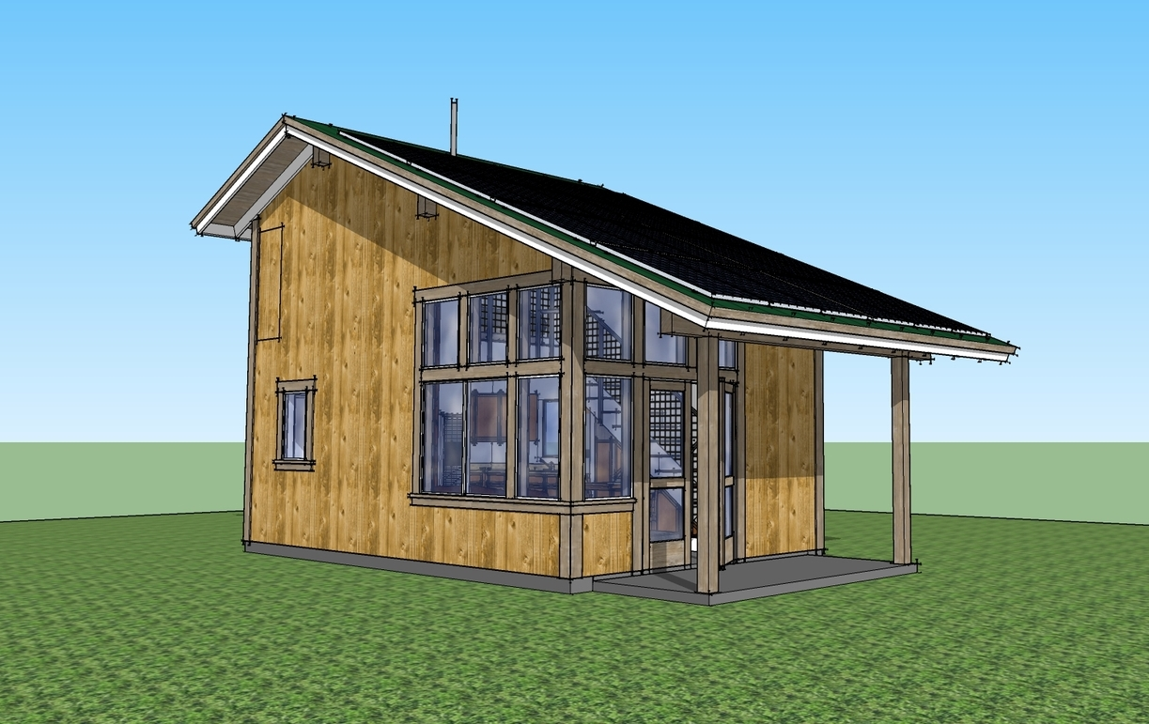
TINY HOME DESIGN
Designed by local architect Karl Eberhard
Home Dimensions: 27’ x 14’ for Studios
Additional One Bedroom Units to add 14’ x 14’
Figure 4-6: Renderings for Tiny Home Designs by Karl Eberhard for Project [2].

Slide 9

SITE DESIGN CRITERIA
Maximize the number of units that have solar panel access to south-side sun
Reduce number of trees to be removed by arranging homes in existing open/flat areas
Reduce amount of cut/fill required by utilizing existing topography
Provide a park area space on the property available by walking access
Figure 7: Tiny Home by Karl Eberhard as basis of design [2]

Slide 10
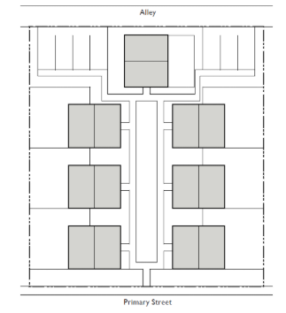
CONFORMANCE WITH CODES
City of Flagstaff Zoning Code 10-50.110.080 Bungalow Court Building Types
One parking space per unit, 3-9 units per lot
Affordable Housing Incentives
Resource Protection Standards
Landscaping Standards Reduction of 10%
Adjustment of Building Form Standards
Figure 8: Bungalow Court Building Type [4]

Slide 11
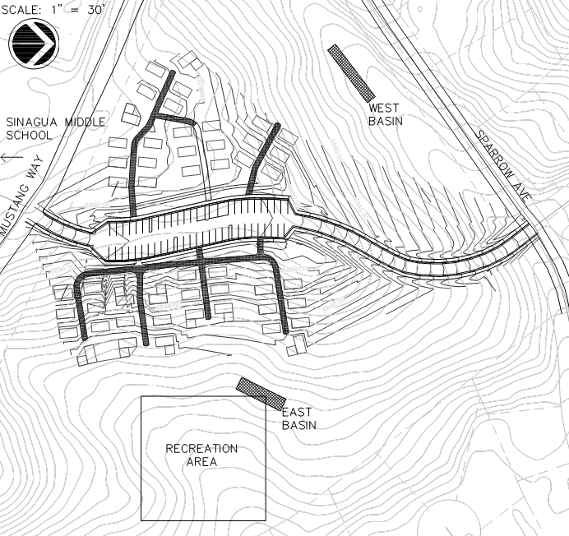
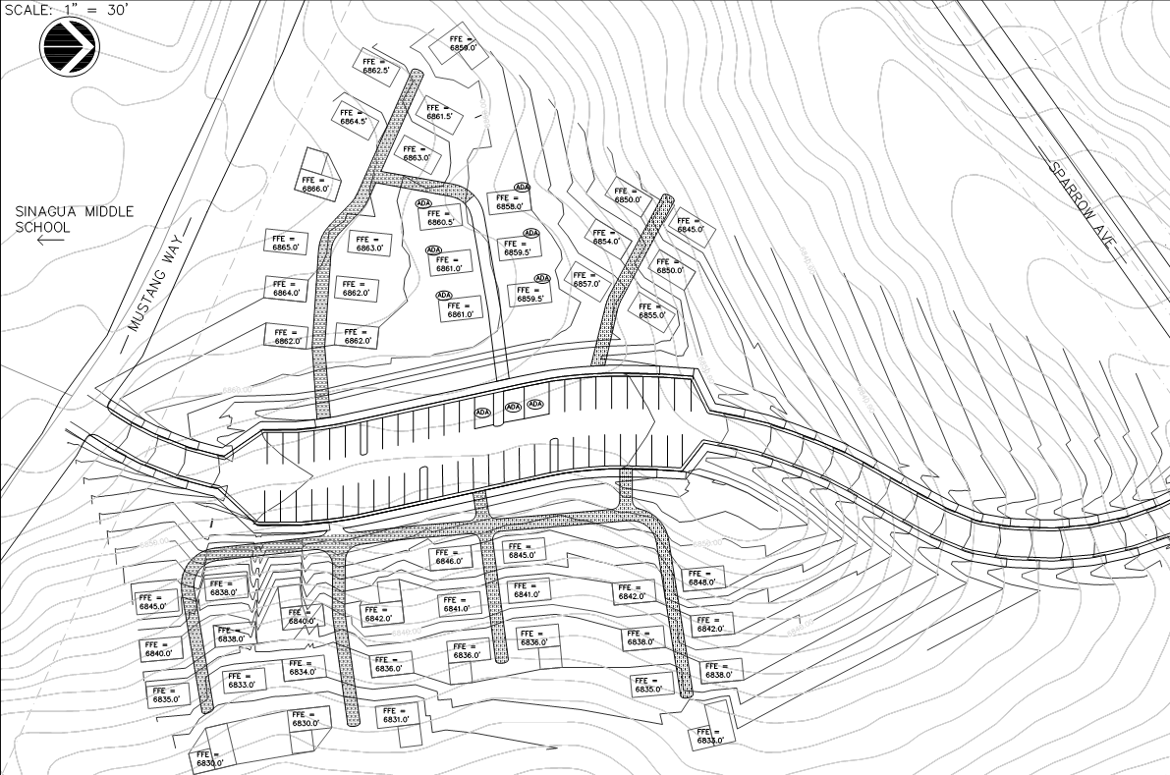
FINAL SITE DESIGN
Total Number of Units: 50
Total Number of Parking Stalls: 51
Number of ADA Accessible Units: 6
Number of ADA Accessible Parking Stalls: 3
Figure 9: Final Site Design for Homes for Teachers development in Flagstaff, Arizona. [1]

Slide 12
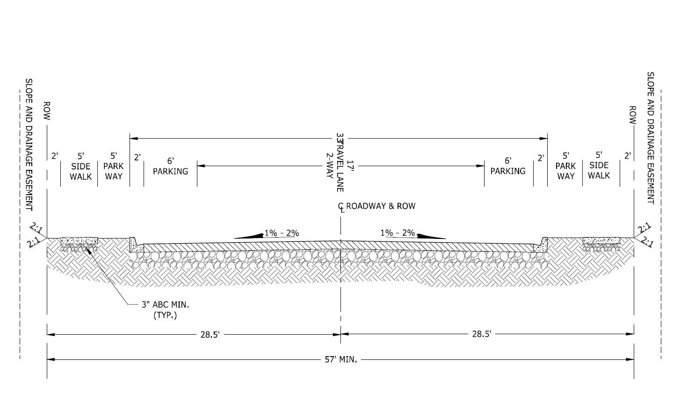
ROAD DESIGN ASSEMBLY
Road Type: Residential Local
Design Speed: 20 mph
Max Grade: 10% with 2% tie-in points
Horizontal Curvature Min: 100’
Lane Width: 8.5 Feet
Curb and Gutter Width: 2 Feet
Sidewalk Width: 5 Feet
Cut and Fill Slopes: 2:1
AC: 3 Inches
ABC: 6 Inches
Sub-base: 4 Inches
Figure 10: COF Detail 10-09-038 for Residential Local Road [4]

Slide 13
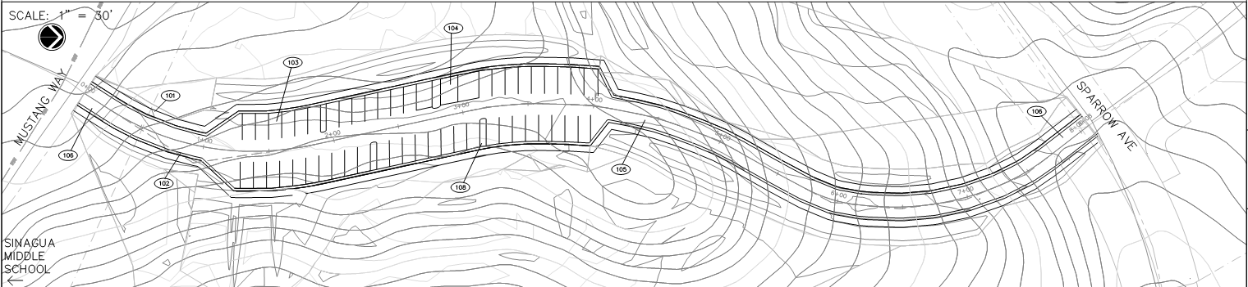
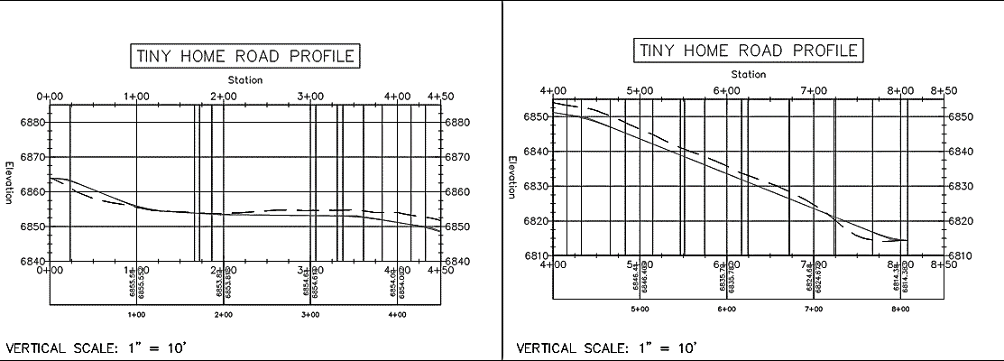
FINAL ROAD DESIGN
Existing Grade
Proposed Road
Figure 11: Final Road Design Plan and Profile for Main Road in Development [4]
10% Grade = Driving Factor of Site Design

Slide 14
GRADING
Table 1: Earthwork Volumes for Homes for Teachers Development
Earthwork Volumes (Cubic Yards)
Total Cut | 4,562
Total Fill | 6,073
Figure 12: Final Grading Design Plan for Homes for Teachers Development [4]

Slide 15
GRADING
Figure 12: Final Grading Design Plan for Homes for Teachers Development [4]
Optimal Building Pads:
ADA accessible units
Concrete sidewalks following slope requirements
Utilizes existing topography
Figure 13: Enlarged Grading Design Plan for Homes for Teachers Development [4]

Slide 16
GRADING
Figure 12: Final Grading Design Plan for Homes for Teachers Development [4]
Challenges in Design:
Units lower than road elevation
Steps required for access
Larger stem walls on houses and routing of runoff required
Figure 14: Enlarged Grading Design Plan for Homes for Teachers Development [4]

Slide 17
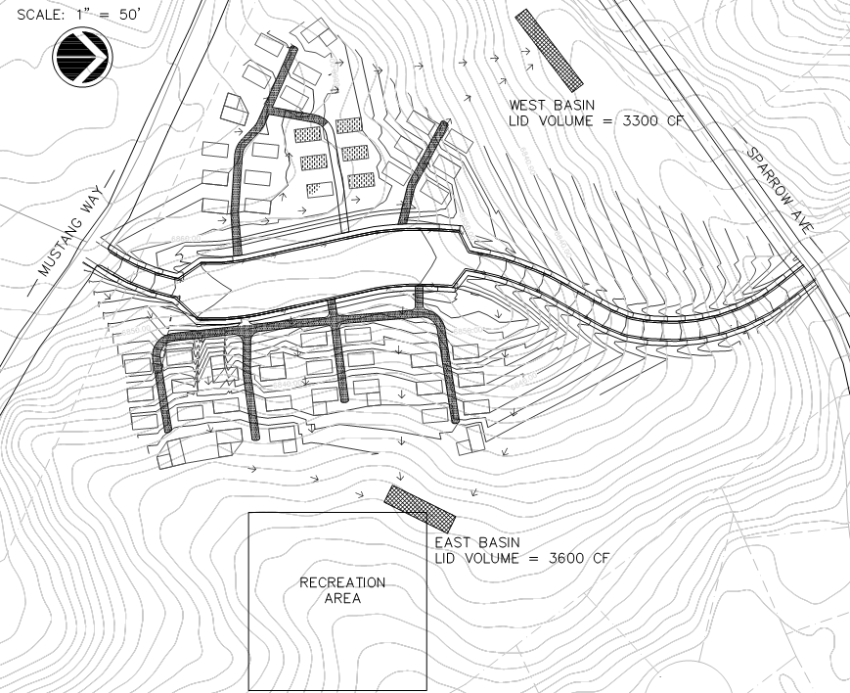
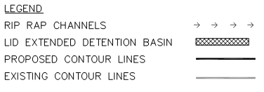

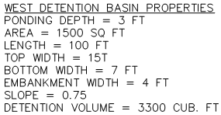
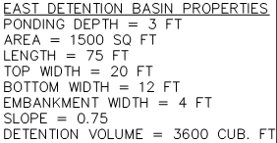
DRAINAGE
Figure 14: Final Drainage Design Plan for Homes for Teachers Development [4]

Slide 18
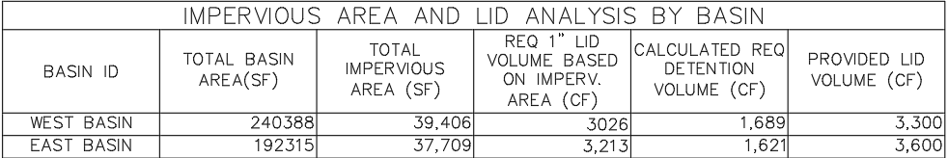
DRAINAGE
Table 2: Drainage Plan Impervious Areas and LID Analysis for Basin Storage
Rational Method utilized
Time of Concentration: 5 minutes
Rip Rap Open Channels used to create flow paths down to LID Basins
Grouted Rip Rap used where velocities approach 18 feet per second
Flow down street gutter will tie into existing infrastructure on Sparrow Ave

Slide 19
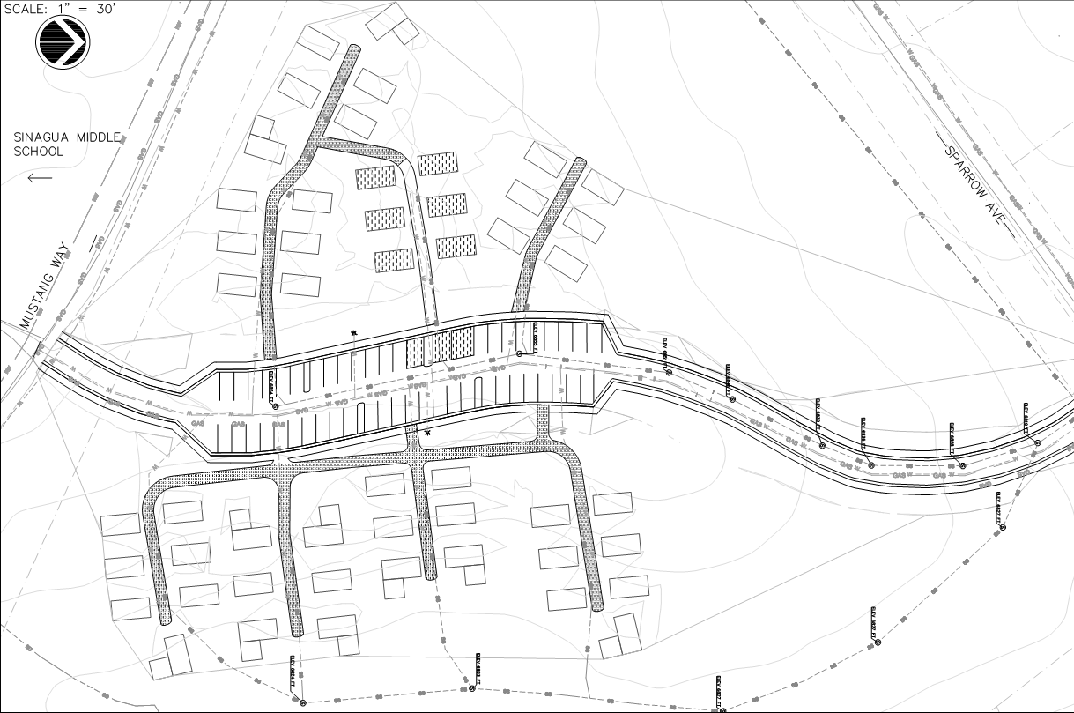
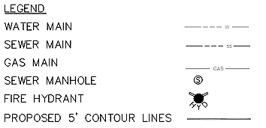
UTILITY LAYOUT
Figure 16 : Utility Layout Alternative 1 with Spanning Sewer Connection Lines[7]

Slide 20
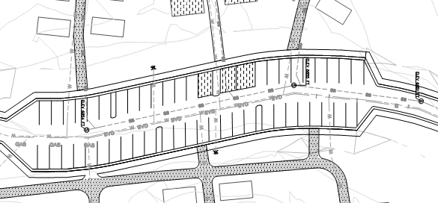
UTILITY DETAILS
Fire Flow Requirement: 1,500 GPM
8” PVC Water Main
8” PVC SDR35 Sanitary Sewer Main
48” Manhole Diameter
Figure 16 : Utility Layout Alternative 1 with Spanning Sewer Connection Lines[7]

Slide 21
UTILITY LAYOUT
Street Tie In
Figure 16 : Utility Layout Alternative 1 with Spanning Sewer Connection Lines[7]

Slide 22
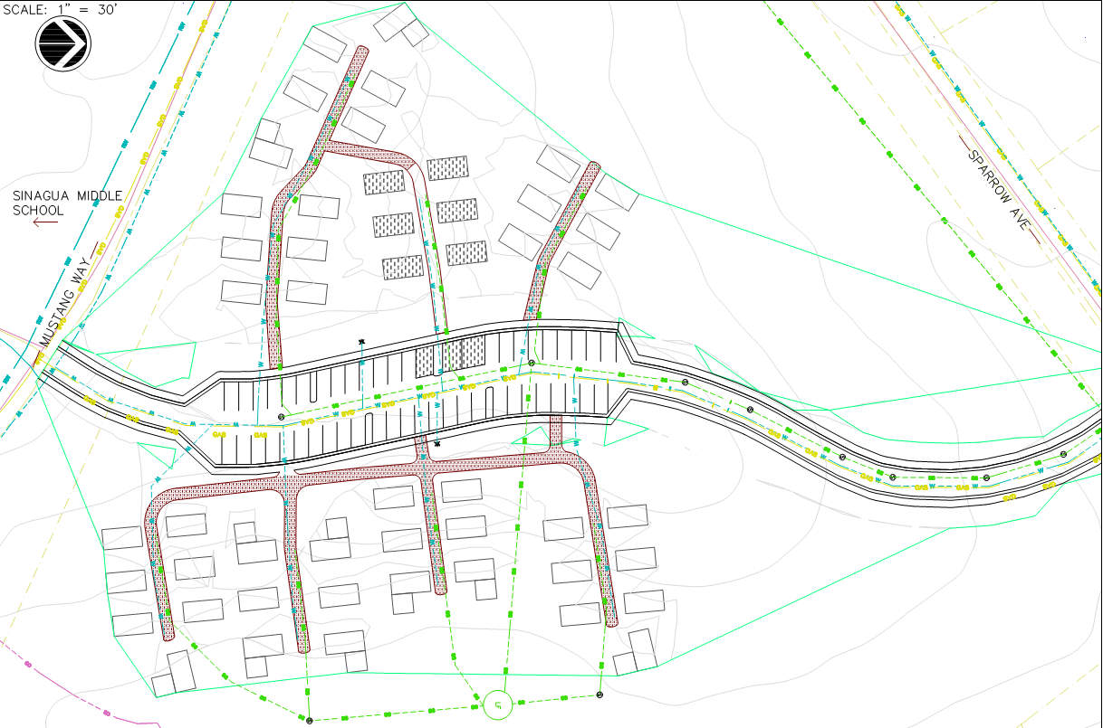
UTILITY LAYOUT - ALTERNATIVE
Figure 17 : Utility Layout Alternative 2 Lift Station Sewer [4]
Alternative 2:
Packaged Lift Station
Figure 17 : Utility Layout Alternative 2 Lift Station Sewer [4]

Slide 23
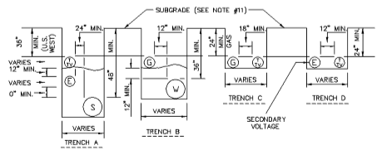
Utility Trench Layout
Water connections at existing pressurized water mains
Minimum space of 12” required between water and gas in horizontal and vertical directions
Water and sewer lines separated 6 ft horizontally and 2 ft vertically
Figure 16 : Engineering Detail 9-01-010 Underground Utilities in Streets Typical Location and Trench Detail [7]

Slide 24
Preliminary Cost Estimate
Table 3: Cost Estimate Breakdown for Development of Infrastructure

Slide 25
CONCLUSION AND RECOMMENDATIONS
Challenges
Topography
Sewer Trenching/ Possible need for lift station
Large amounts of cut and export of rock
Permitting and Plan Review Challenges
Value Engineering Recommendations
Master Meters vs. Individually Metered
Residential Local Road vs. Residential Wide Road
Decomposed Granite Walkways

Slide 26
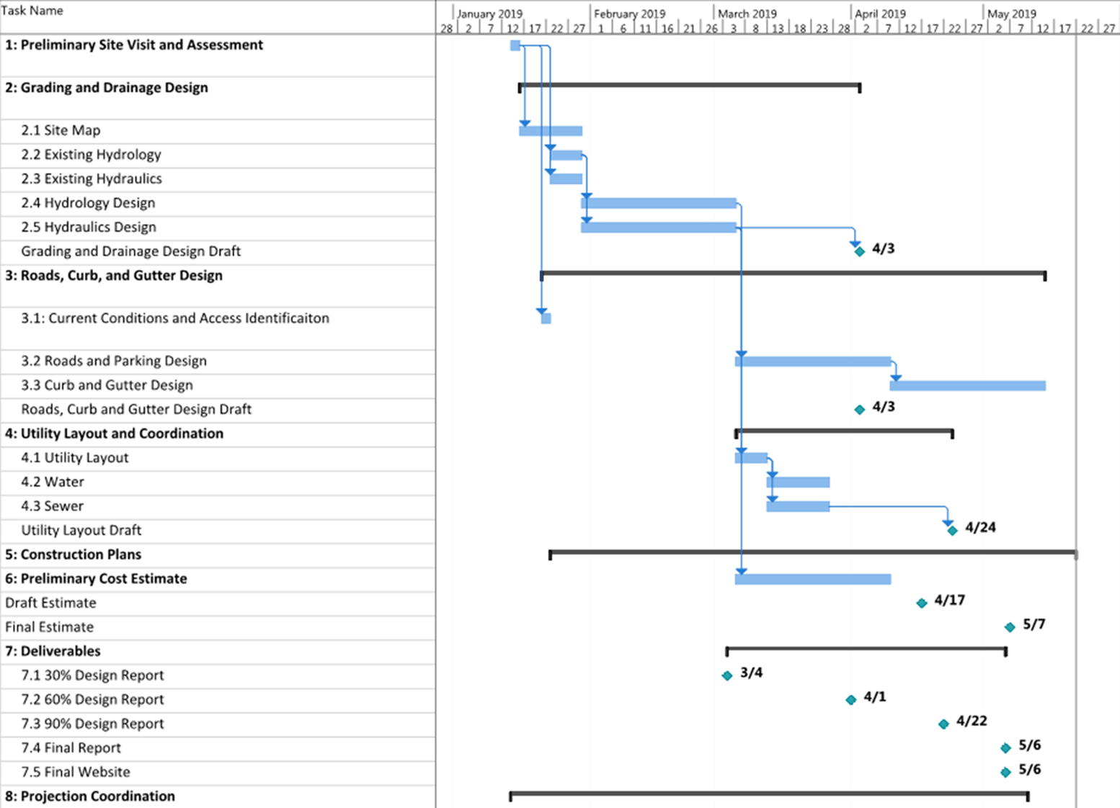
Figure 17: Original Gantt Chart Schedule for the Tiny Home Affordable Housing [1].

Slide 27
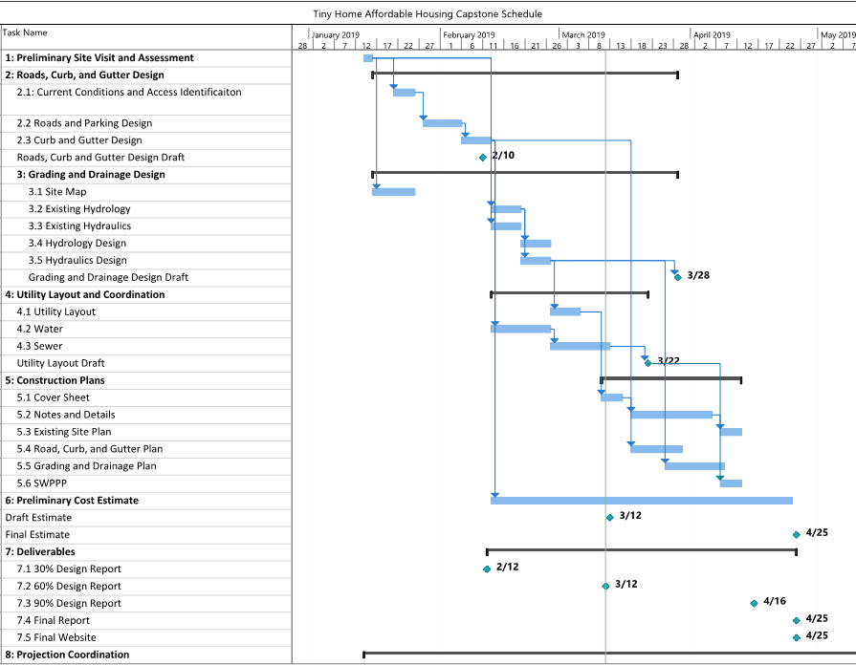
Figure 3: Updated Gantt Chart Schedule for the Tiny Home Affordable Housing [1].

Slide 28
STAFFING
Table 4: Project Member Titles and Abbreviations for staffing of the Affordable Housing Tiny Home Project [1]
SENG | ENG | EIT | INT
Senior Engineer | Engineer | Engineer in Training | Intern
Table 5: Original Hours provided for each project member for each task listed [1]

Slide 29
STAFFING
Table 6: Project Member Titles and Abbreviations for staffing of the Affordable Housing Tiny Home Project [1]
SENG | ENG | EIT | INT
Senior Engineer | Engineer | Engineer in Training | Intern
Table 7: Updated Hours provided for each project member for each task listed [1]

Slide 30
COST OF ENGINEERING SERVICES
Table 8: Cost of Engineering Services Breakdown for Personnel and Travel on the Tiny Home Affordable Housing Site Design [1]
Table 9: Cost of Engineering Services Breakdown for Personnel and Travel on the Tiny Home Affordable Housing Site Design [1]

Slide 31
REFERENCES
[1] Habitat for Humanity Tiny Homes Affordable Housing Site Design Proposal for Flagstaff Unified School District in Flagstaff, Arizona. ABK : Anna Kurn, David Borja, Michael Bulriss, Abdulrahim Abdullah, Mobarak Alsulaiman. CENE 476 Capstone : https://onedrive.live.com/view.aspx?resid=565C70869A7714A1!116&ithint=file%2cdocx&app=Word&authkey=!AmFru8ZQYdBNQkQ
[2] Karl Eberhard, Tiny Home Designs. https://karleberhard.com/multifamily/#/habitat-soliere/
[3] Habitat for Humanity Tiny Homes Affordable Housing Site Design Proposal for Flagstaff Unified School District in Flagstaff, Arizona. Anna Kurn, David Borja, Michael Bulriss, Abdulrahim Abdullah. CENE 486 Capstone: Report. Available: https://nau0-my.sharepoint.com/:w:/r/personal/alk299_nau_edu/_layouts/15/Doc.aspx?sourcedoc=%7B7764cc5e-9fbb-4301-8510-6df88ffef1f1%7D&action=default&gad=2574
[4] City of Flagstaff, "Title 10: Flagstaff Zoning Code," 24 January 2019. [Online]. Available:
https://www.codepublishing.com/AZ/Flagstaff/.
[5] City of Flagstaff, “Stormwater Management Design Manual – City of Flagstaff” Created March 2009. [Online]. Accessed March 2019. Available: https://www.flagstaff.az.gov/DocumentCenter/View/58133/SWMgmtDesignManual-3-09?bidId=
[6] City of Flagstaff, “Sparrow Ave Record Drawings FINAL”. September 18th, 2018. Print.
[7] “Engineering Detail 9-01-010: Underground Utilities in Streets Typical Location and Trench Detail,” City of Flagstaff Engineering Standards. [Online]. Available: https://www.flagstaff.az.gov/DocumentCenter/View/14939/Title-23-APPENDIX-A---STANDARD-DRAWINGS?bidId=. [Accessed: 05-Mar-2019].

Slide 32
QUESTIONS?

